Slide 1
Produce Item Recognition For Retail Stores Based on Machine Learning
Presented by:
Adarsh Koppa Manujunath-200397257
Stephen Bello- 200397257
Iveatu Obioha-200412752
April 06, 2020

Slide 2
PROJECT DEVELOPMENT WITH THE ROLE OF EACH TEAM MEMBER
1. Development of Data science business problem to be solved
By - Iveatu, Adarsh and Stephen
2. Brand New Dataset Creation of fruits and Vegetable
By - Iveatu and Adarsh
3. Model Planning
By - Adarsh, Iveatu and Stephen
4. Model Building
By - Adarsh
5. App Development and Integration
By- Stephen and Adarsh

Slide 3
OUTLINE
Introduction
Problem Statement
Solution Overview
Approach
5. Fruits and Vegetable Data Set
Machine Learning Models
Model Testing
Produce Item Recognition Application
Outcomes

Slide 4
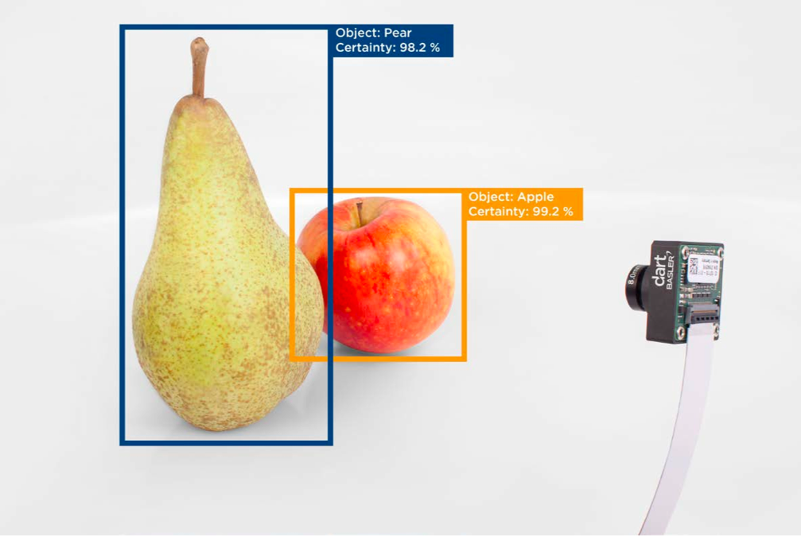
INTRODUCTION
Retail Store Produce Items do not have UPC tag
Manual Code input takes 2-3 minutes on average when shoppers do not know code
Image Recognition will help in scanning item with in 4 seconds.
https://in.pycon.org/cfp/2017/proposals/fruits-classification-using-deep-learning~dL5je/

Slide 5
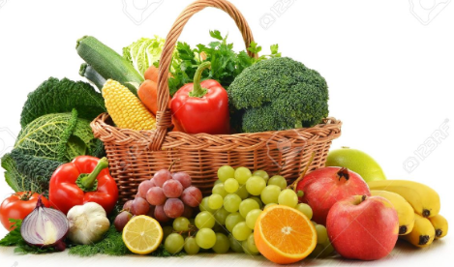
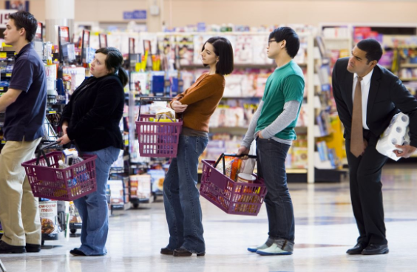
PROBLEM STATEMENT
Takes 10-15 minutes of time to checkout when customer buys fruits and vegetables in bulk
Customers in queue would be disappointed
Inconvenient and time consuming, when customer do not bother to note down UPC code and ask staff at the checkout
Fruits and Vegetables
Long Checkout Queue

Slide 6
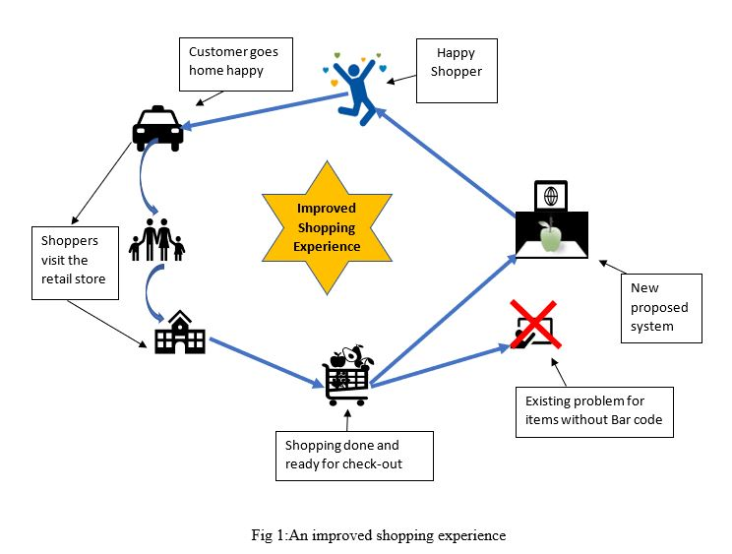
SOLUTION OVERVIEW
At checkout,POS should provide an option to scan by Image
Image Recognition technique help in identify the produce item with in 4 seconds
Saves a lot of time
Solution Overview

Slide 7
APPROACH
Fruits and Vegetable Data Set
Machine Learning Models
Model Testing
Produce Item Recognition Application

Slide 8
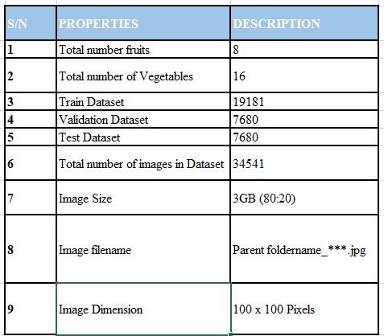
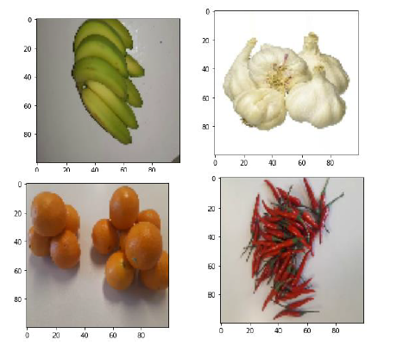
FRUITS AND VEGETABLES DATA SET
Created a custom Data Set of 24 fruits and vegetables
Data Set include diverse images
Total of 34,541 images
Fruits and Vegetable Data Set Summary
Sample Images
24 Fruits and Vegetables considered

Slide 9
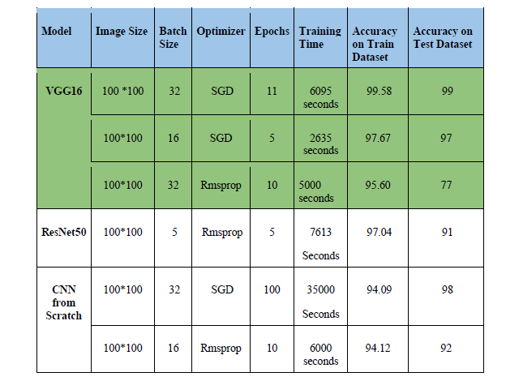
MACHINE LEARNING MODELS
VGG 16
Resnet 50
CNN from scratch
VGG16 is the best in terms of training accuracy, loss and time
Light weight model can be easily integrated with POS
Machine Learning Mode Performancel Comparison

Slide 10
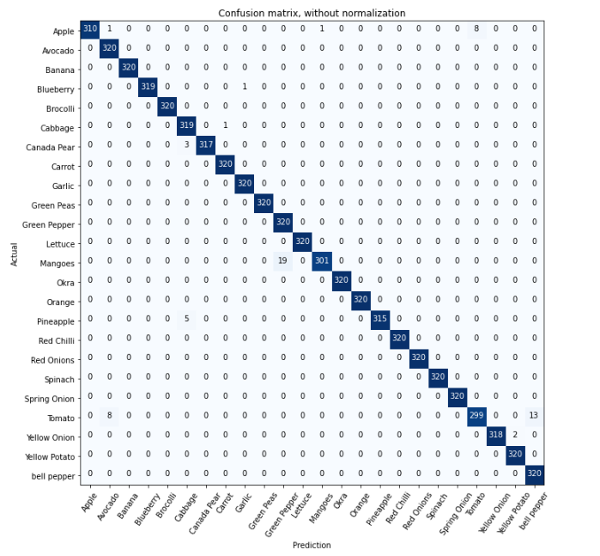
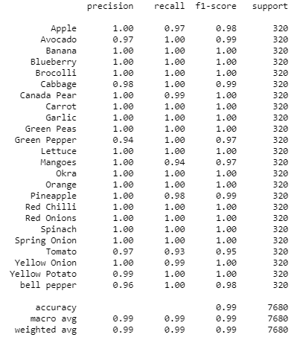
MODEL TESTING
Model is tested with unseen produce items.
Testing Accuracy is 99%
Confusion Matrix
Classification Report

Slide 11
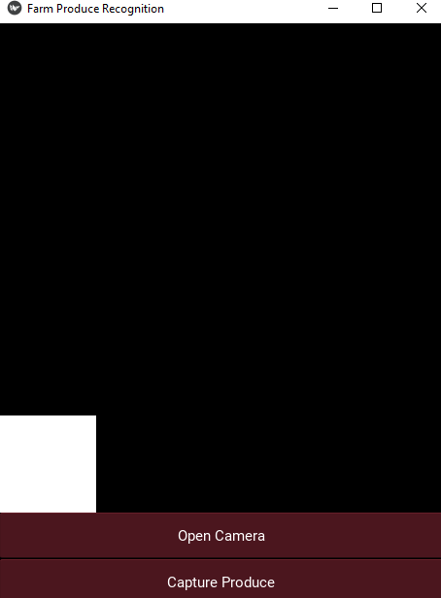
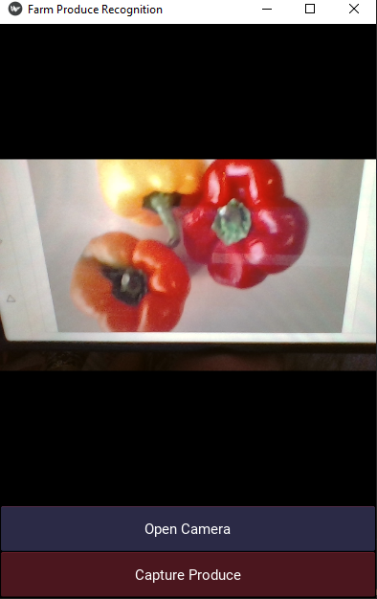
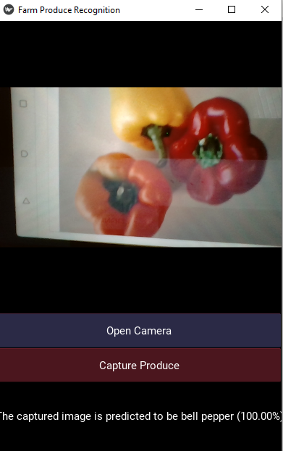
PRODUCE ITEM RECOGNITION APPLICATION
Windows Application is developed for the demo
Same Model can be integrated with POS as well

Slide 12
OUTCOMES
Long check out queue can be avoided
Check out time is shortened to 3-4 seconds from 2 minutes
Technique can be applied on more bulk items
Maintenance is easy, application can be enhanced to more fruits and vegetables always.
12

Slide 13
Thank You

